Slide 1
Building an
Agile, Mobile First,
Banner Integrated, and Highly Available Portal on Open Source Software
Part 1 – Demonstration, Rationale, and Overview
Albert Holtsclaw
Database Administrator

Slide 2

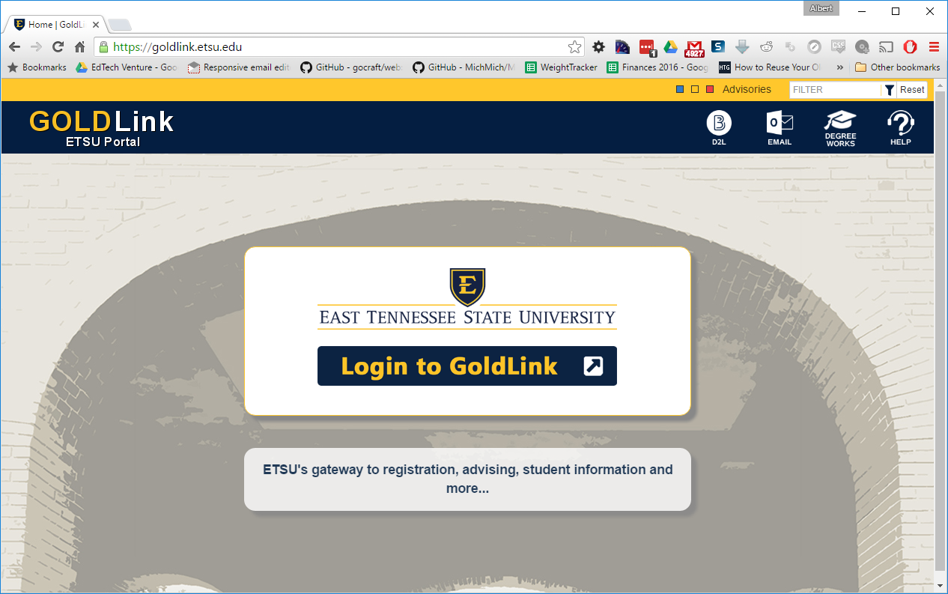
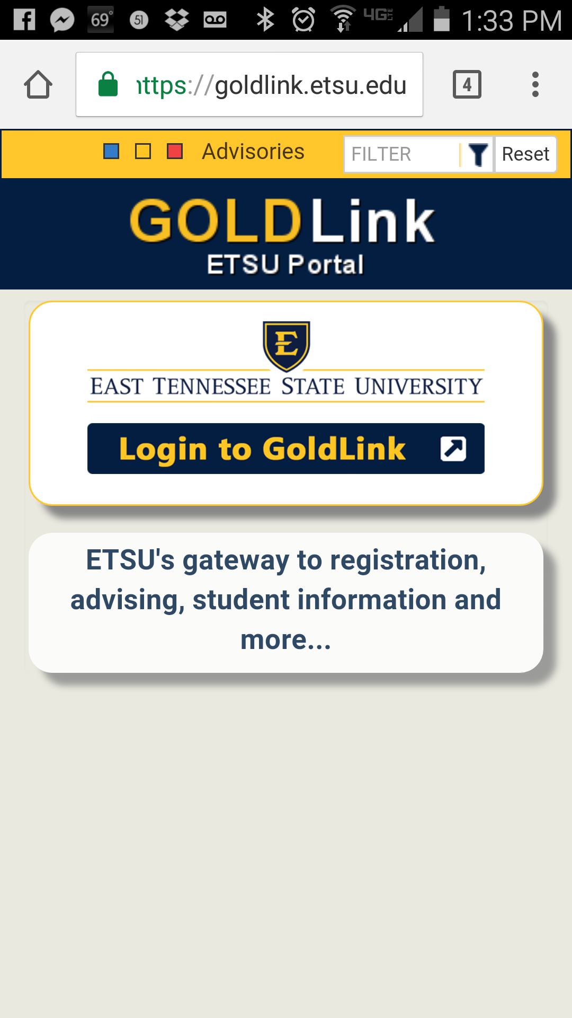
Demonstration
Notes:
Project Goals
Reduce Resources Need to Run and Maintain
Reduce Complexity / Unnecessary Functionality
Achieve High Concurrency and High Availability
Maintain Banner Roles Functionality
Maintain Banner “Channels” Functionality

Slide 3
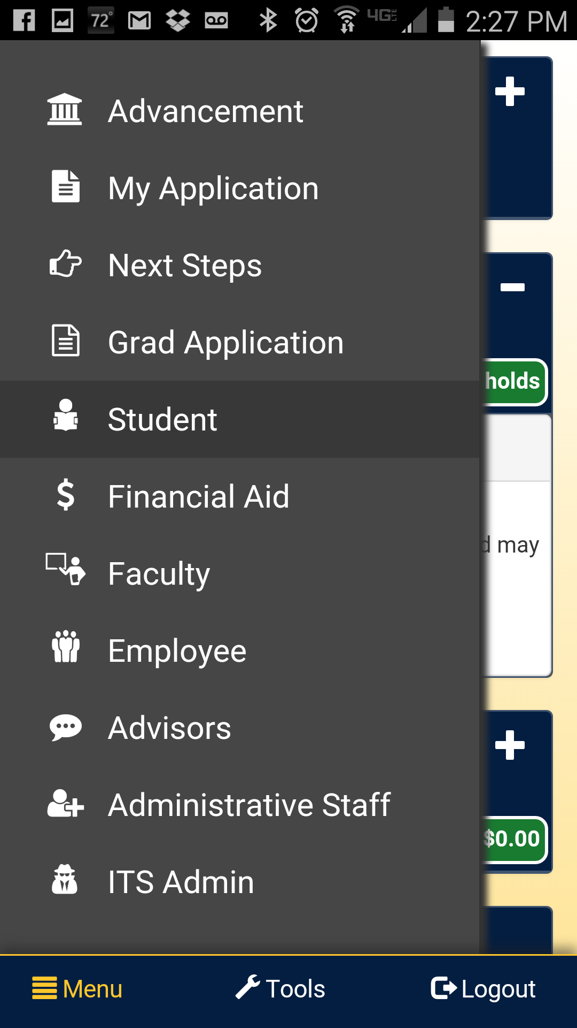
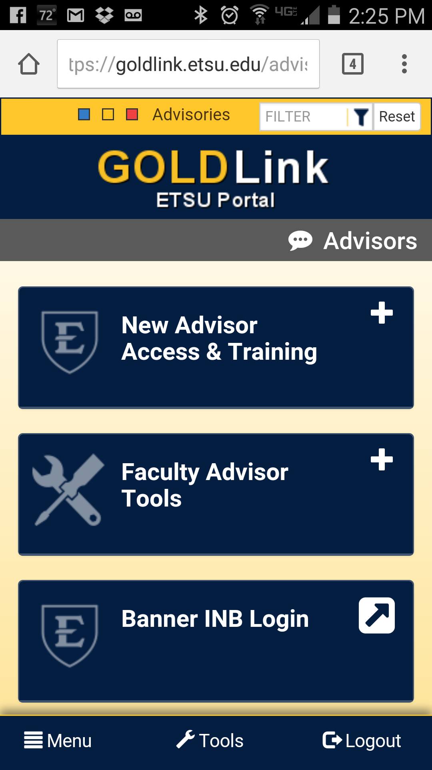
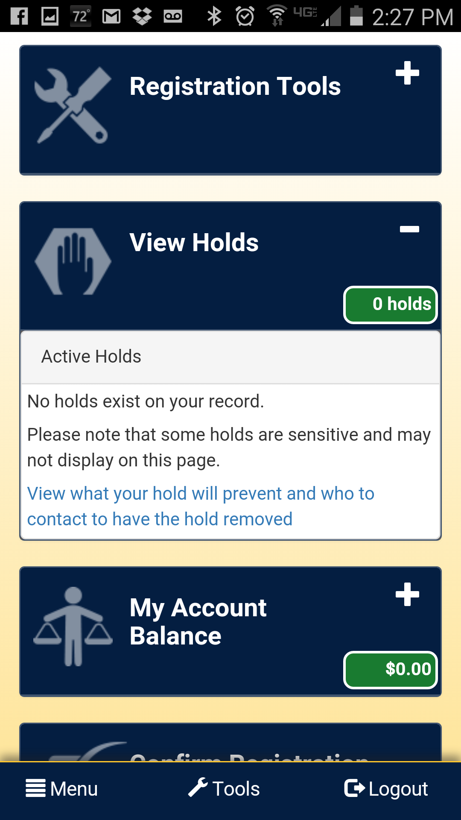
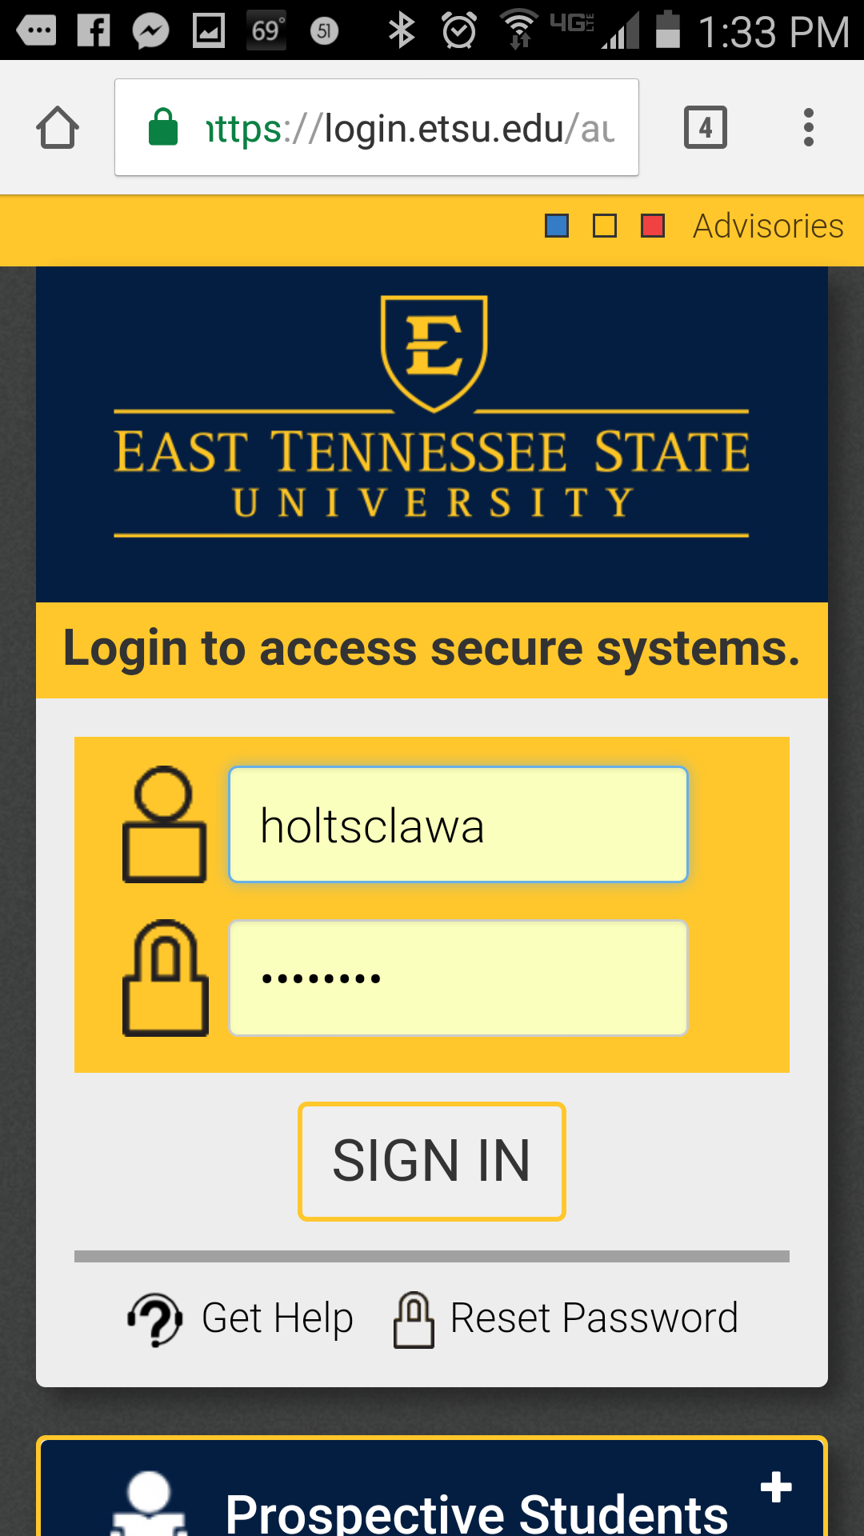
Mobile First Demo

Slide 4
Catalysts for Change
Luminis 4 – End of Life - Dec 31, 2016
Eroding “because we pay for it" argument
Dissatisfaction with Luminis product line
Do we even need a portal?

Slide 5
Dissatisfaction / Luminis Concerns
Distance/time between source and campus
  Jasig -> Ellucian -> TBR -> Campus
  Liferay -> Ellucian -> TBR -> Campus
Age of Product / Modernization / Mobile First
Size of User Base
Unneeded / Unused features
Technology Stack (Java)
Complexity, Maintainability, Performance

Slide 6
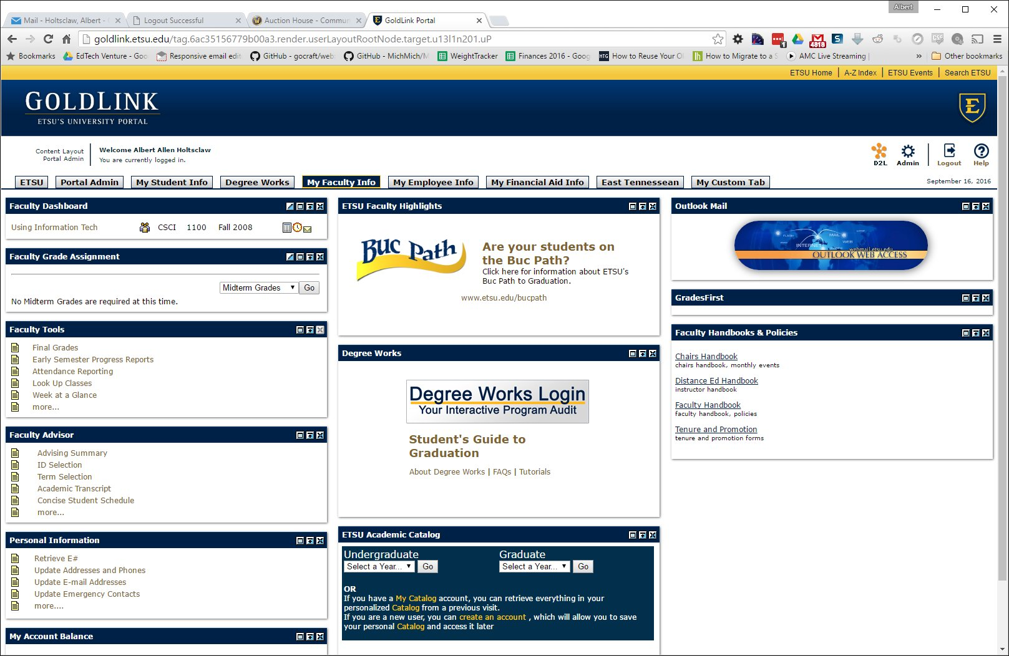
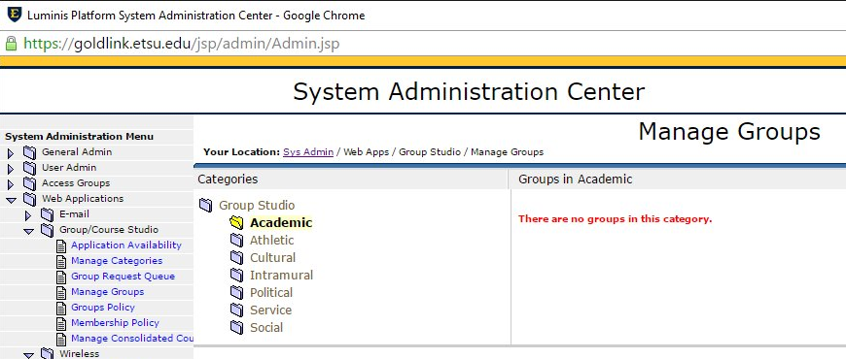
Dissatisfaction / Concerns – Lum 4
Not Mobile Friendly
Unused Features

Slide 7
The Options
No Portal
Luminis 5
Ellucian Portal
Custom Portal
  Based on existing solution / framework

Slide 8
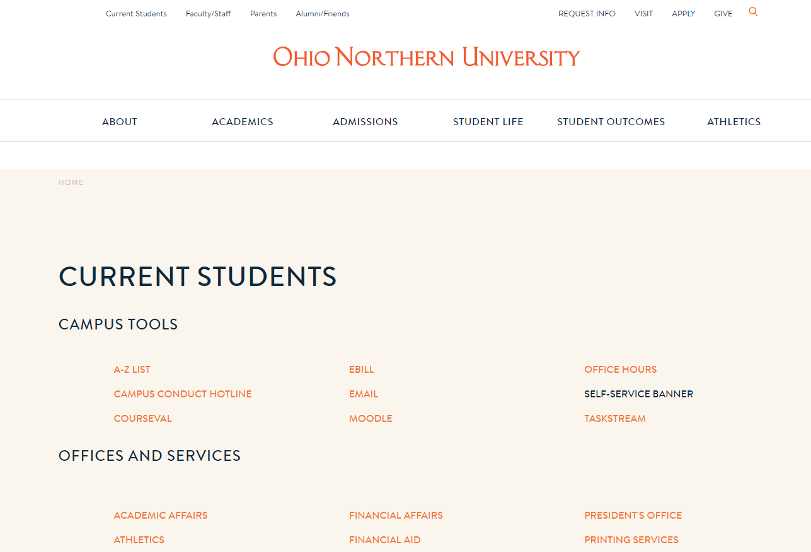
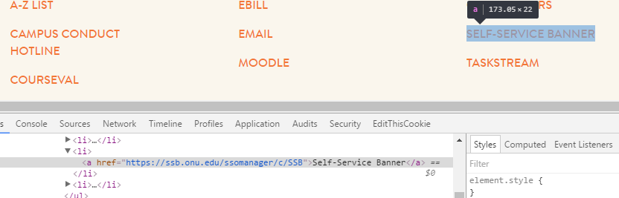
The “No Portal” Option

Slide 9
Project Goals
Reduce Resources Need to Run and Maintain
Reduce Complexity / Unnecessary Functionality
Achieve High Concurrency and High Availability
Maintain Banner Roles Functionality
  i.e. Content Targeting on Banner Roles
Maintain Banner “Channels” Functionality
ADA / Accessibility Compliant (WCAG / Section 508)
Easily Modify Behavior / Extend Functionality
Mobile First Experience
Notes:
Project Goals
Reduce Resources Need to Run and Maintain
Reduce Complexity / Unnecessary Functionality
Achieve High Concurrency and High Availability
Maintain Banner Roles Functionality
Maintain Banner “Channels” Functionality

Slide 10
Analyzing the Options: Features
Feature | Luminis 4 | Luminis 5 | Ellucian Portal / Sharepoint * | What we need
Role-based Content | X | X | X | X
Banner-integrated Content / Channels / Portlets | Channels | Portlets | Web Parts | X
Announcements | X | X | X | X
Mobile Friendly / Responsive |  | lp5-theme | Bootstrap 3.0 ? | X
Single Sign-on / SSO/ CAS | X* | X | EIS ? | X
Customizable tab / “homepage” | X | X | ?
Built-in Email / Chat | X | External | External
File Sharing | X | X | X
Message Boards | X | X | X
News Module / Aggregator | X | X | X
Calendar | X | External | X

Slide 11
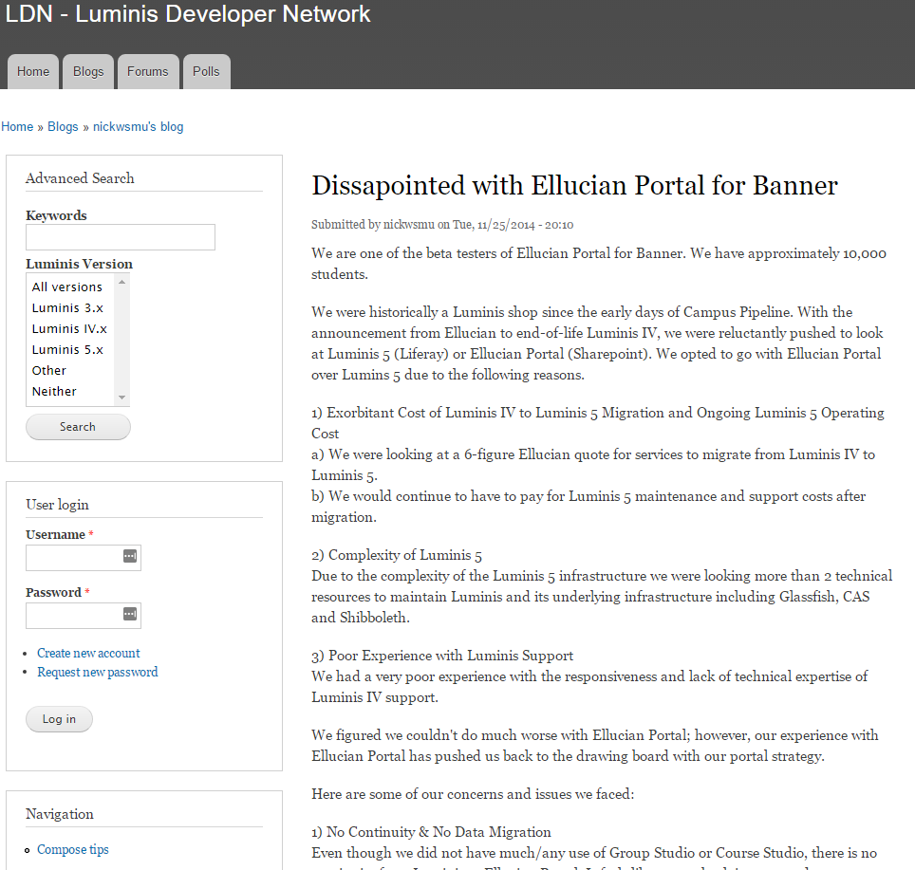
Analyzing the Options: Concerns
Luminis 5
  Cost (Hardware / Maintenance)
  Complexity (DB + LDAP config. store, Admin Node, Web Nodes, Jackrabbit repo., etc.)
  “Enterprisey” – unneeded features
  Support / Official and Community
  Java / Performance / Scalability
  Accessibility issues may require plugins
    Bootstrap Accessibility Plugin
Ellucian Portal / SharePoint
  Cost (Hardware, Software - SharePoint, Maintenance)
  Complexity
  Support / Official and Community
  Less Mature
https://www.lumdev.net/node/13519

Slide 12
Analyzing the Options: Custom Build
Joomla
  Pros
    Large community – widespread use
    Out-of-the-box CMS
  Cons
    Community extensions often locked behind paywall or license
    Unknown scalability or performance
WordPress
  Pros
    Tons of plugins, themes, and community support
    Large community – widespread use
  Cons
    Requires customization to behave as “true” CMS
    Roles integration difficult / one role per user
    Common target for exploits

Slide 13
Analyzing the Options: Custom Choices
Plone
  Pros
    Highly secure (few CVEs – Common Vulnerabilities and Exposures)
    Accessible and scalable out of the box
  Cons
    Limited features and fewer community modules
    Bulky and potentially difficult to manage and maintain
    Niche market / smaller support community
Uportal and Liferay
  Both dismissed due to relationship with Luminis 4 and 5 platforms respectively
    Missing Banner integration compared to Luminis with the same base platform
    “might as well go with Luminis”

Slide 14
Analyzing the Options: Custom Choices
Drupal
  Pros
    Huge community of quality / free modules
    Documented case studies and sample configurations for performance and scalability
    Highly extendable / modifiable through conventions and existing modules
    Mature code base (Drupal 7) and multiple years remain on security updates
    Huge support community and examples
  Cons
    Popularity – common target for exploits
    Framework design
      Multiple ways of accomplishing goal
      No official “best practices” and inconsistent community solutions

Slide 15

Analyzing the Options: Drupal
The GRAMMYs / Grammy.com Case Study
  https://www.lullabot.com/podcasts/drupalizeme-podcast/grammycom
  https://www.lullabot.com/articles/drupal-wins-grammycom
Whitehouse.Gov
  https://www.drupal.org/whitehouse-gov-launches-on-drupal-engages-community
Others
  University of Oxford, NBC, BBC, MTV,
  The Weather Channel, The Official Beatles Website
“Try thinking more, if just for your own sake”

Slide 16
Drupal: Portal Overview
Components
  Custom Modules
    Banner Roles
    Banner Channels
  Community Modules
    CAS, Panels, Panes, Panel Schedules, and more
  Custom Sub-theme
    Based on Bootstrap 3, custom layouts, template overrides
    Focus on usability and accessibility
Integration
  Ellucian Ethos Identity
    Formerly Ellucian Identity Service (EIS)
    CAS for BEIS SSOManager (INB, SSB) / Workflow / DegreeWorks / ePrint
Notes:
No deep dive, just mention components and overview of interactions

Slide 17
Drupal: Banner Roles Module
Relies on community CAS module to create user account on CAS first login
Uses Drupal Hooks framework for hook_user_login
Syncs roles for CAS-authenticated, non-admin users
  Fetches roles from custom PL/SQL package through custom DAD on SSB server
    /DRUP/BYWDRUP.p_roles?username=
    Pulls from INTCOMP roles already defined (GORIROL + GOBTPAC)
  Creates “banner_<rolename>” roles in Drupal as needed using Drupal API
    banner_student, banner_faculty, banner_alumni, banner_employee, etc.
  Saves roles to user using Drupal API
~50 lines of PHP for core functionality – without code golfing.
Notes:
No deep dive, just mention components and overview of interactions

Slide 18
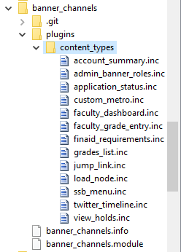
Drupal: Banner Channels Module
Relies on community modules
  CTools (Chaos Tools) and Custom Content Panes
Defines custom panes / “content types” as panel plugins
Fetches XML from same custom PL/SQL package as Roles
  /DRUP/BYWDRUP.p_chan_grades_list?username=
  Which, in turn, can consume existing channel XML
    wtailor.twbcmain.f_main_xml(p_channel_name => 'SI_GRADES‘…)
Builds HTML content based on returned XML
Exposes customization options / settings through Drupal API
Allows for extensibility / custom channels
  View Holds, Application Status, etc.
Notes:
No deep dive, just mention components and overview of interactions

Slide 19
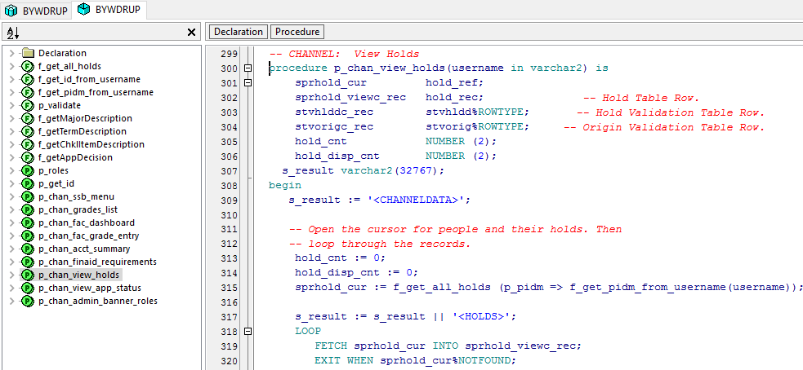
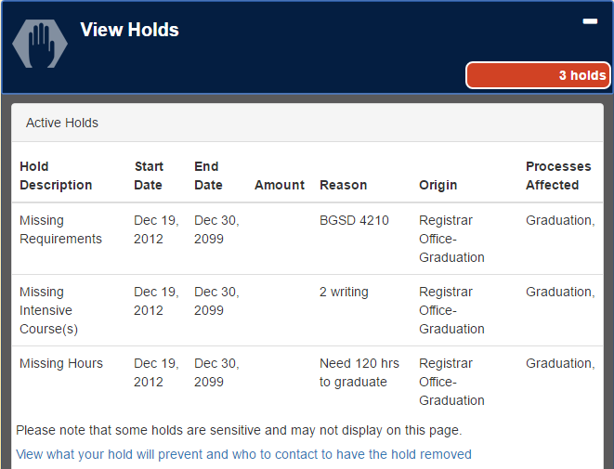
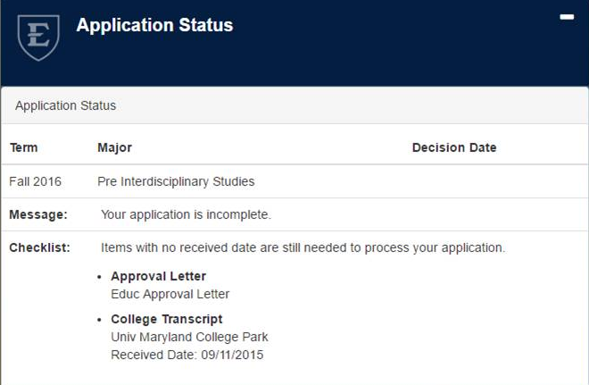
Custom Channels

Slide 20
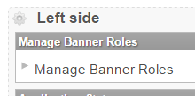
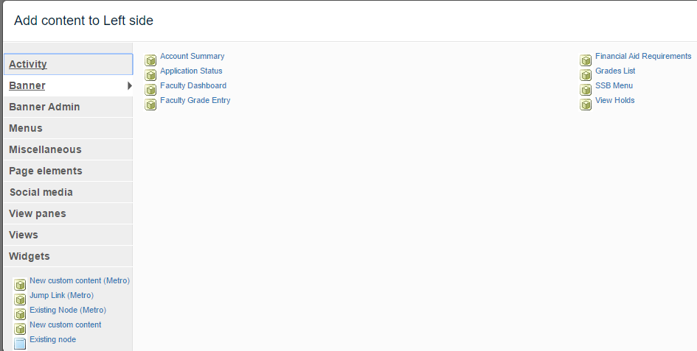
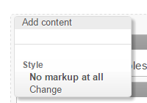
Adding Channels as Content Panes

Slide 21
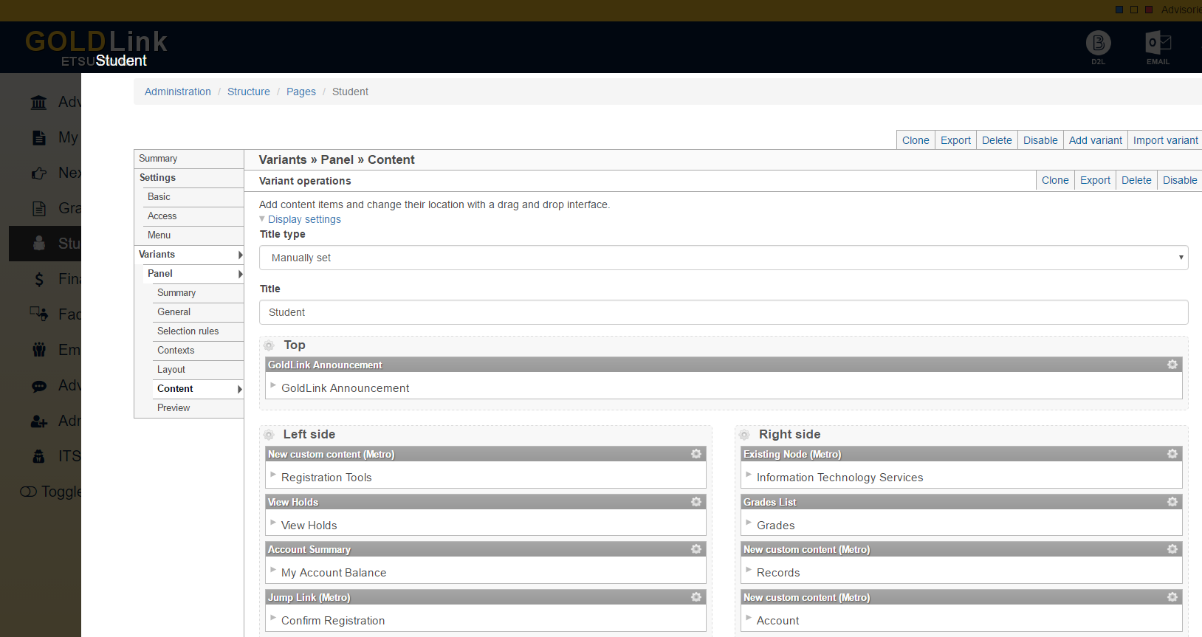
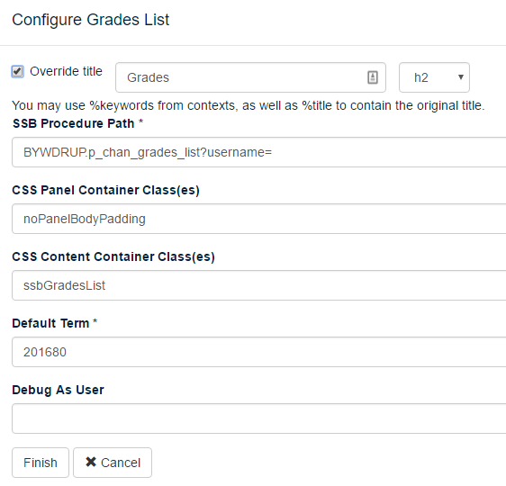
Admin: Layouts, Panels, Panes, and Channels

Slide 22
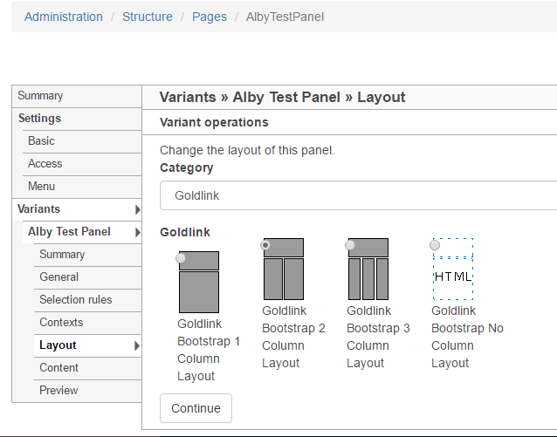
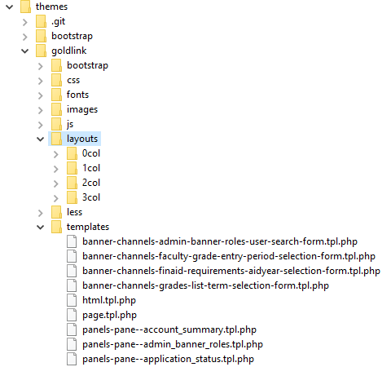
Panel Page Layouts and Themes

Slide 23
Goals Restated / Achieved
Reduced Resources Need to Run and Maintain
Reduced Complexity / Unnecessary Functionality
Achieved High Concurrency and High Availability
Maintained Banner Roles Functionality
  i.e. Content Targeting on Banner Roles
Maintained Banner “Channels” Functionality
ADA / Accessibility Compliant (WCAG / Section 508)
Easily Modify Behavior / Extend Functionality
Mobile First Experience

Slide 24
Part 2 Teaser – Infrastructure
CAS / Authentication Provider
Software Stack / Hardware
System Components and Configuration
Web Node
Web Node
Web Node
MariaDB
(master)
MariaDB
(master)
MariaDB
(master)
“The tech and how it all fits together”
Drupal
(Apache + PHP)
Drupal
(Apache + PHP)
Drupal
(Apache + PHP)
Software Architecture and Requirements
Configuration
Load Balancing / Scaling
Performance Details
How to do this yourself, or something like it…
And more…
Redis Sentinel
Redis Sentinel
Redis Sentinel
HAProxy
HAProxy
HAProxy
Redis Master
Redis Slave
Notes:
No details, just teaser image

Slide 25
Questions?
Continued in Part 2 – Infrastructure
w/ Ian Dillon, Lead DBA - ETSU
Albert Holtsclaw
holtsclawa@etsu.edu

